Slide 1


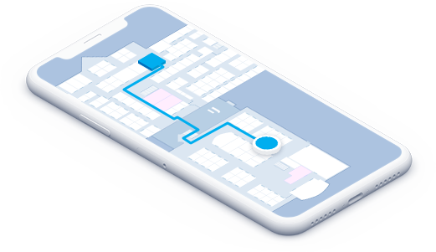
Indoor Navigation using Augmented Reality
Preethivardhan (160117737102)
Pavan Kalyan (160117737100)

